Slide 1
Collecting your sample and
returning it to the laboratory
is a simple process!

Slide 2
Geauga County Department of Water Resources
REMEMBER!
Your sample bottle is STERILE, which means you MUST take care to avoid contaminating the sample bottle!
Do NOT touch the inside of the bottle cap or the inside of the bottle, and do not place the cap face down on any surface.
Do NOT rinse the bottle out prior to collection, as there is a chemical additive inside the bottle that neutralizes chlorine that may be present in the water.
Do NOT touch the bottle to the sink tap when filling, as that could potentially contaminate the sample.
Do NOT use leaky faucets, outdoor faucets, hot water heaters or pressure tanks; remove the aerator, and put softener/filter system on bypass, as these are potential sources of contamination.

Slide 3
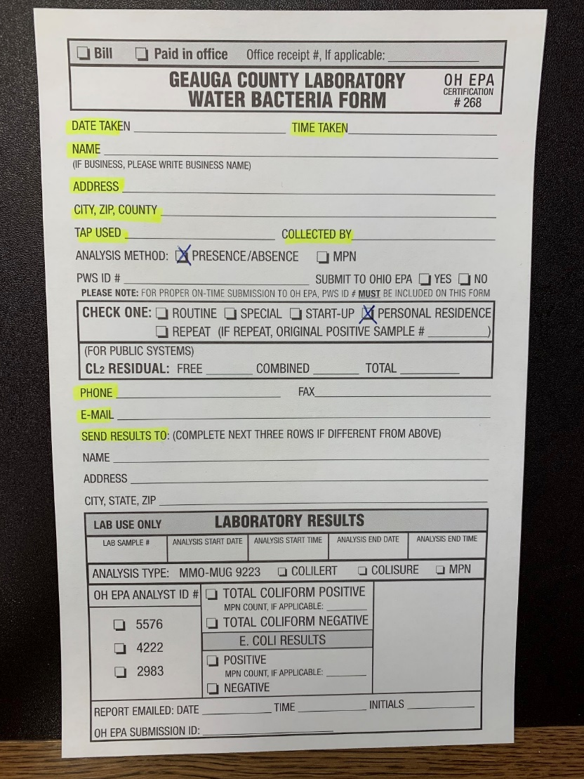
Taking your sample:
Choose your faucet—keep in mind the types of faucets/taps to avoid.
Remove the aerator from the faucet and place your softener/system on bypass.
Sanitize the tap nozzle with sanitizing solution (1 TBS bleach per half gallon water) by either using a spray bottle to saturate the opening or a plastic bag to squeeze the solution into the faucet.
Open tap fully and flush for 3-5 minutes, and then reduce flow enough to allow sample bottles to be filled without splashing.
Fill sample bottle to just below the neck and avoid contaminating the bottle.
Do not allow the sample bottle to overflow and recap sample bottle tightly.
Refrigerate sample until being transported to lab.
Fill out paperwork as completely as you can!

Slide 4
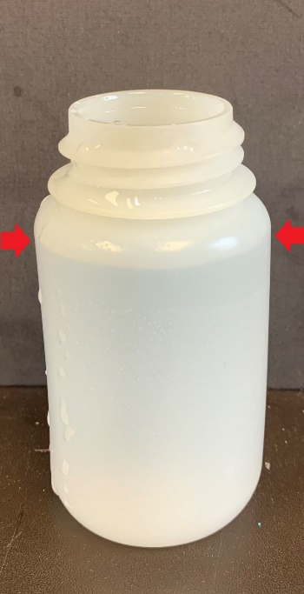
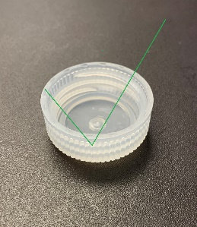
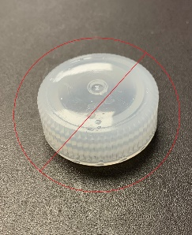
TAKING YOUR SAMPLE
Do NOT overfill
Do NOT let bottle
touch tap
Fill to just below
bottle neck
Do NOT
store cap
upside
down

Slide 5
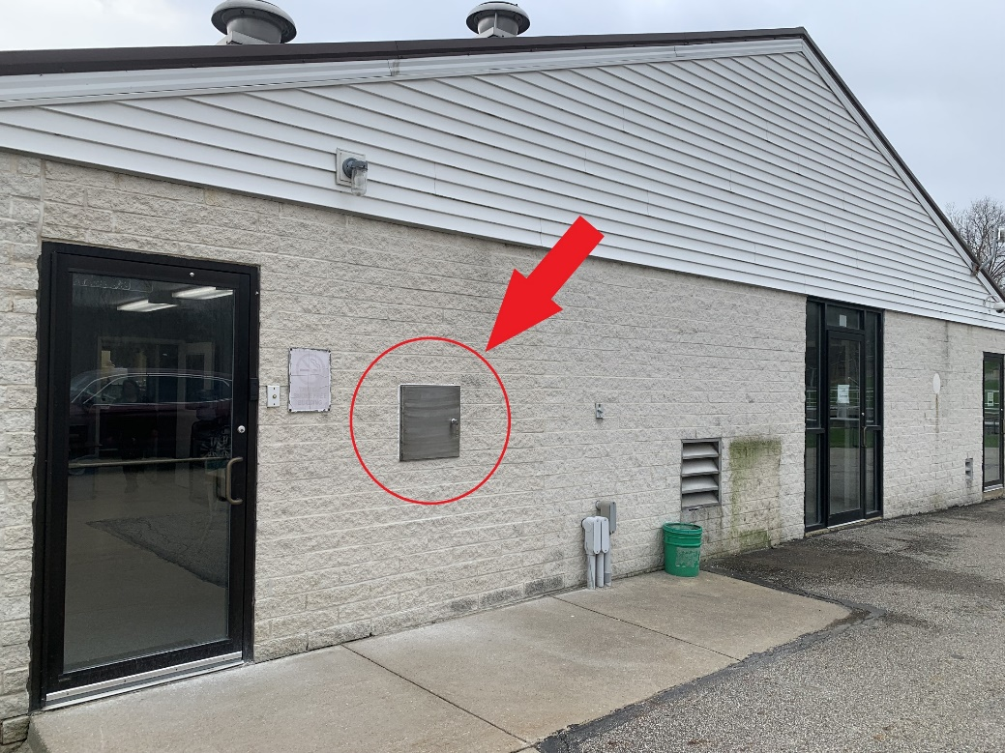
Returning your sample to the lab:
Samples are accepted at the laboratory Mondays, Tuesdays and Wednesdays. Samples may be brought in Thursdays as well, but the laboratory must be notified beforehand. No samples are accepted on Fridays, Saturdays or Sundays.
Laboratory hours are 7 am – 4 pm every day and samples may be dropped of at any point during the day.
Return samples as soon as possible after collection, but at least within 12 hours.
Samples may be placed in the Total Coliform drop box located on the side of the laboratory. No need to sign in…just drop sample and go!
Feel free to come into the lab with any questions.
Lab Contact Info:
(440) 279-1975
13335 Aquilla Rd.
Chardon, OH 44024

